Slide 1
Galaxies
BY Kashif ul Kubra
6th (Blue)
R.P. School, HMT

Slide 2
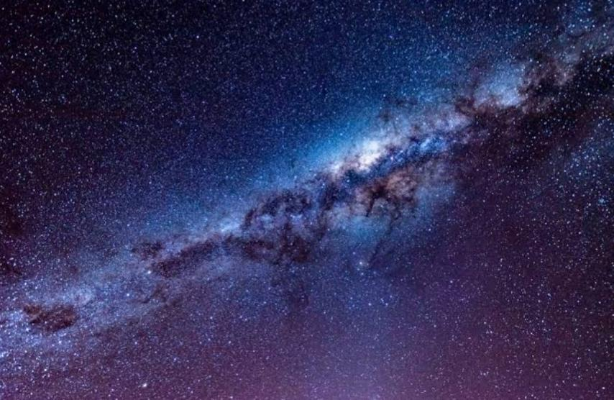
Galaxy
A galaxy is a gravitationaly bound system of stars, stellar remnants, interstellar gas, dust and dark matter.

Slide 3
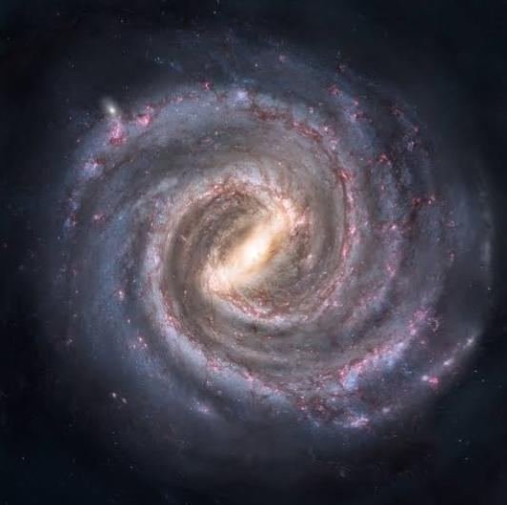
Milky way
The Milky Way is a galaxy that that contains our Solar System.
It’s made up of 90% dark matter and about 10% luminous matter.
We’re about 26,000 light years from the center of the galaxy, on the inner edge of the Orion-Cygnus Arm.

Slide 4
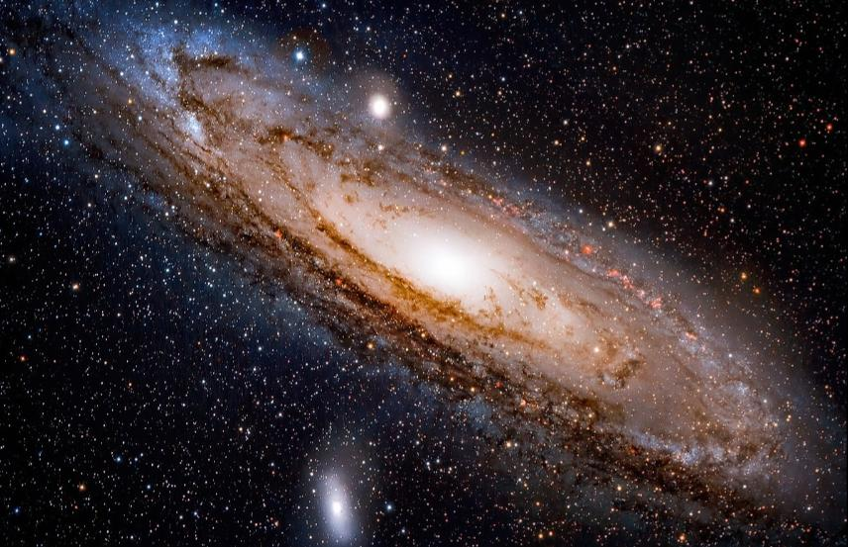
AndRomeda galaxy
The Andromeda Nebula is also known as Messsier 31, M31 or NGC 224.
It’s a barred spiral galaxy approximately 2.5 million light years from Earth.
It’s the nearest major galaxy to the Milky Way.

Slide 5
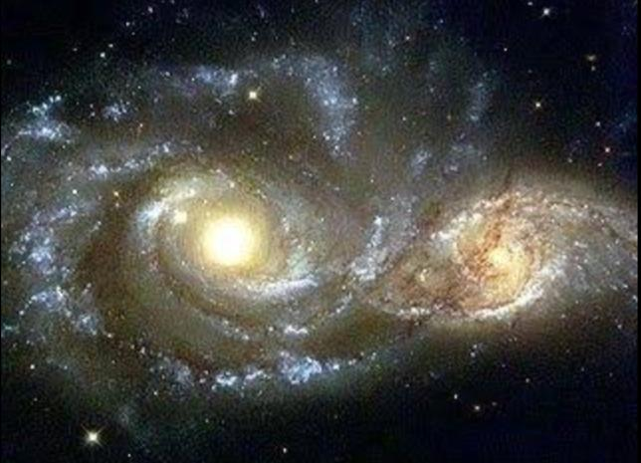
Canis major dwarf galaxy
It’s a disputed dwarf irregular galaxy in the Local Group.
It’s located in the same part of the sky Canis Major.
It consists of four globular clusters that measure some 10,000 light-years in diameter.

Slide 6
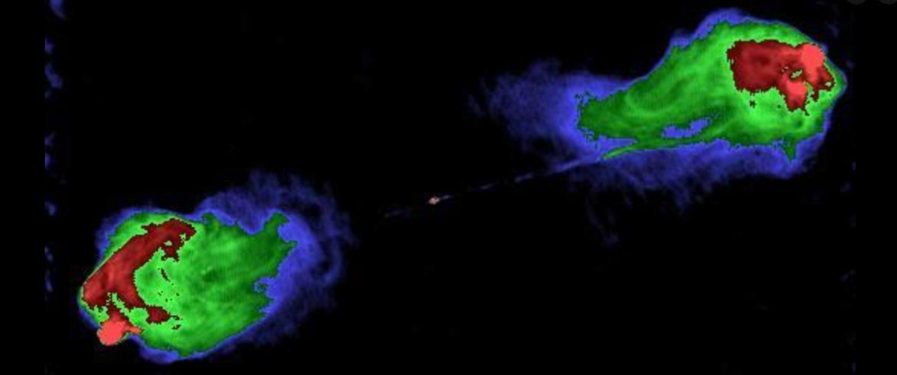
Cygnus a
Cygnus A is a radio galaxy, and one of the strongest radio sources in the sky.
It consists of 6 bright stars asterism of a cross comprised of 9 main stars.
There are 84 Bayer/Flamsteed designated stars within its confines.

Slide 7
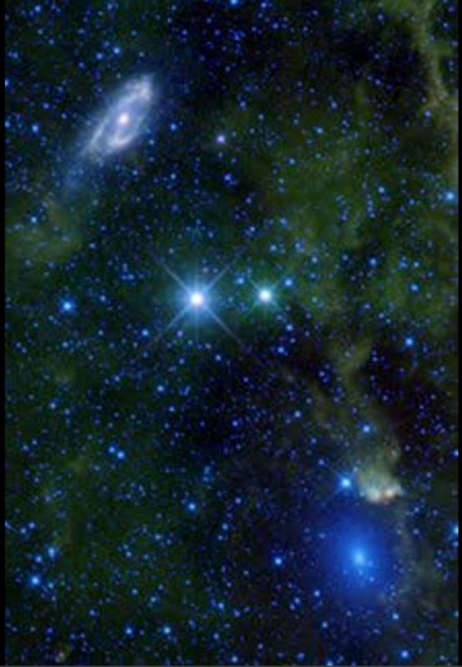
Maffei I
It’s a massive elliptical galaxy in the constellation Cassiopeia.
It’s made mainly of metal-rich stars.
It was named after Paolo Maffei who discovered it in 1967.

Slide 8
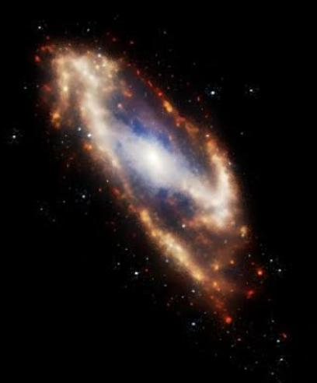
Maffei Ii
Maffei II is an intermediate spiral galaxy.
It’s about 10 million light-years away in the constellation Cassiopeia.
It was also discoverd by Paolo Maffei in 1968.

Slide 9
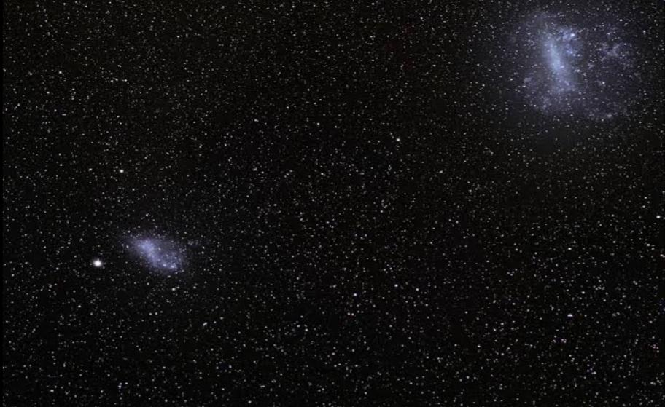
Magellanic clouds
The Nubecluae Magellaniare two irregular dwarf galaxies visible in the Southern Celestial Hemisphere.
They are members of the Local Group and are orbiting the Milky Way galaxy.
These companion galaxies were named for the Portuguese navigator Ferdinand Magellan.

Slide 10
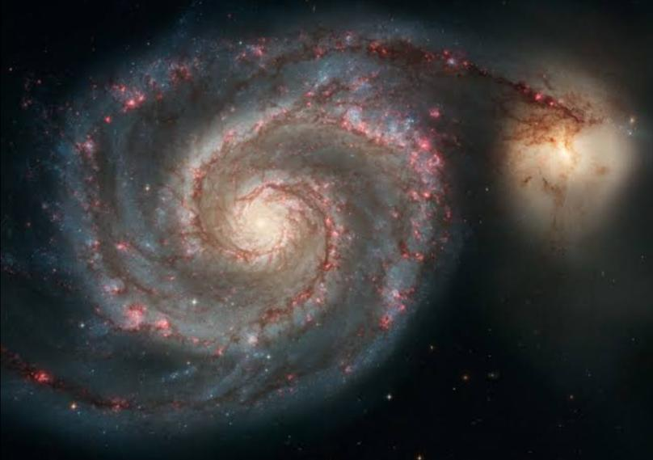
Whirlpool Galaxy
It’s also known as Messier 51a, M51a and NGC 5194.
It’s an interacting grand-design spiral galaxy with a Seyfert 2 active galactic nucleus.
It was the first galaxy to be classified as a spiral galaxy

Slide 11
The end

